Slide 1
Final Proposal
Edward Mapp

Slide 2
Concept of the Site
Movie info site
Upcoming movies
Movie descriptions
Method of keeping track of upcoming movies

Slide 3
To Do List
Bootstrap alerts
Bootstrap carousel
Bootstrap buttons
Bootstrap cards
CSS styles
Media queries

Slide 4
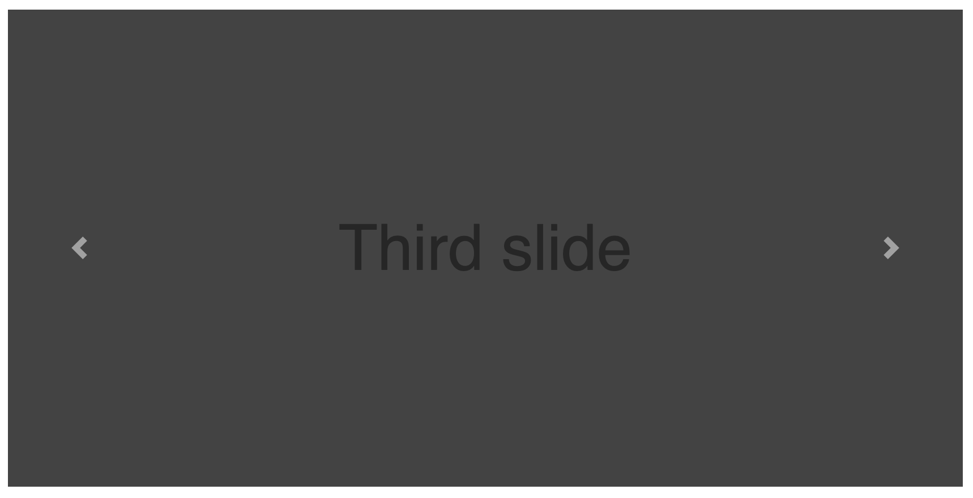
Each carousel for each month
Movie thumbnail
Movie title
Movie info

Slide 5
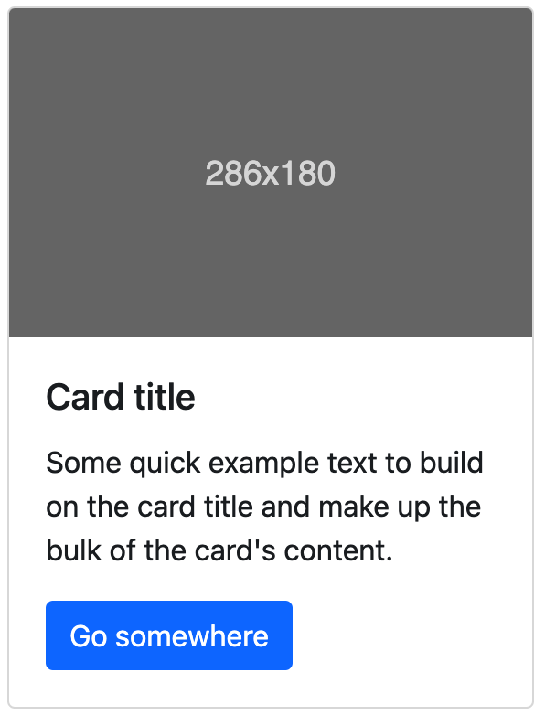
Trailer thumbnail
Movie title
Trailer description
Button linking to trailer

Slide 6
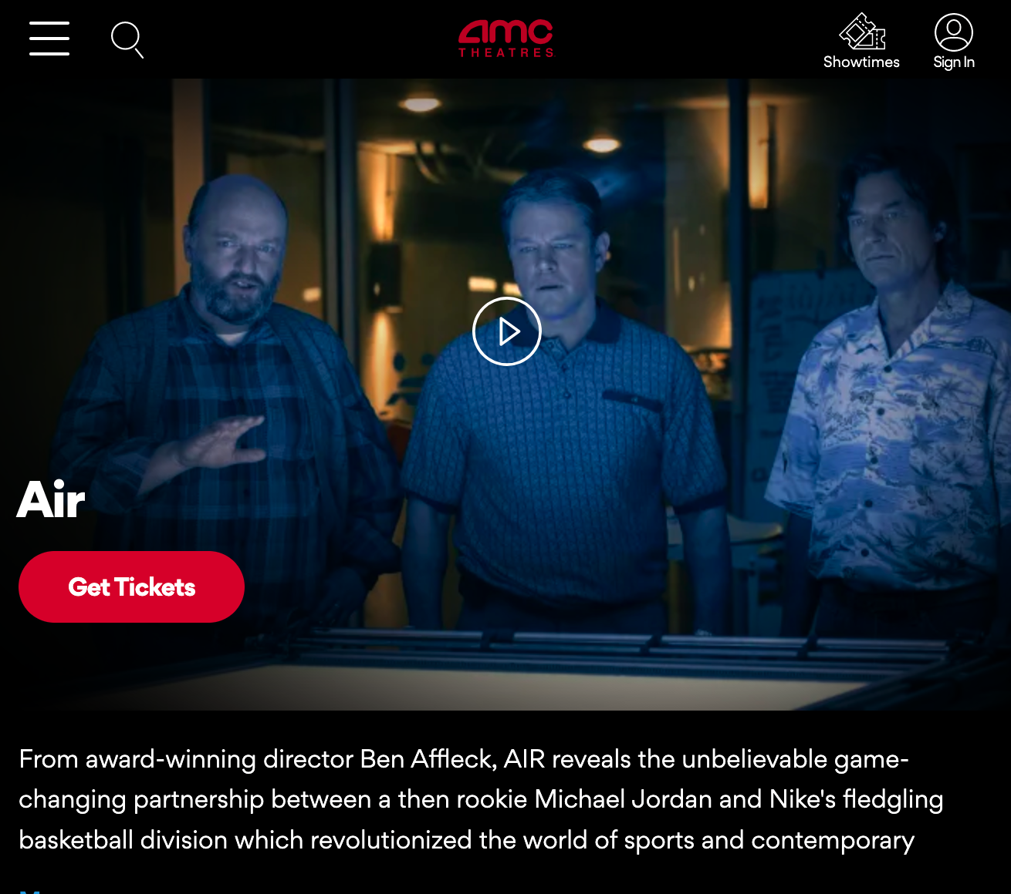
Site Inspiration
https://www.amctheatres.com/movies/air-72500
Movie Title
Poster/Wallpaper
Description
Genre
Release Date
Director
Cast
Trailer Link

